Slide 1
Capability Framework

Slide 2
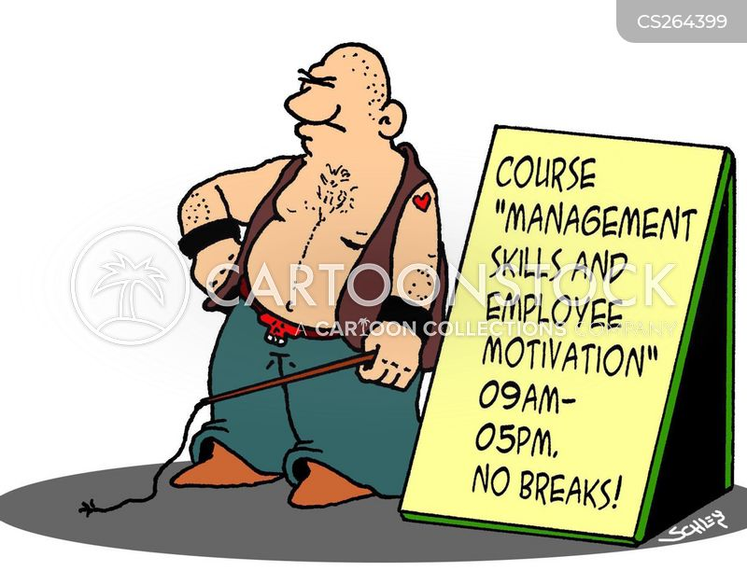

Slide 3
Capabilities frameworks
Nobody can agree how many capabilities a manager needs or what they are, but this is how the University of Otago describes the purpose of its own capabilities framework:
“The Capability Framework provides a common foundation and common language to describe the knowledge, skills and abilities needed to perform work across all levels of the organisation.
The Capability Framework is applied consistently across professional staff roles. It is used as part of a job description for describing a job; and along with goals and objectives, and service standards, it provides information about the requirements for staff undertaking the work.
It underpins a consistent and equitable approach to professional staff career pathway planning, and the identification of focused training and development activity for career progression between roles.”

Slide 4
Capabilities frameworks
There are 18 specific capabilities in the OU Capability Framework. These are arranged into five capability groups, each with several sub-sections, which span all professional staff jobs from entry level to the most senior management roles :
Engage
Enable
Personal Attributes
People Management
Language & Culture.
Each capability has five work complexity levels, they are:
Foundational
Intermediate
Adept
Advanced
Highly Advanced
Find out more here: https://www.otago.ac.nz/humanresources/otago689242.pdf

Slide 5
Capabilities frameworks
Some models contain as few as five capabilities:
Technical skills - Knowledge of and proficiency in activities involving methods, processes, and procedures. Most managers, especially at the lower and middle levels, need technical skills for effective task performance.
Conceptual skills - Conceptual skill is the ability to see the “big picture,” to recognize significant elements in a situation and to understand the relationships among the elements. It requires having the ability to visualize the enterprise as a whole, to envision all the functions involved in a given situation or circumstance, to understand how its parts depend on one another and anticipate how a change in any of its parts will affect the whole.
Interpersonal and communication skills - Communication skill for a manager is a must. The manager must be able to convey ideas and information to others and receive information and ideas from others effectively.-
Decision-making skills - In simple words, a manager’s job is to make decisions that will lead the organization to the attainment of is goals.
https://www.iedunote.com/managerial-skills

Slide 6
Capabilities frameworks
The Education Leadership New Zealand framework lists these nine main areas:
Building and sustaining high trust relationships
Ensuring culturally responsive practice and understanding of Aotearoa New Zealand’s cultural heritage, using Te Tiriti o Waitangi as the foundation
Building and sustaining collective leadership and professional community
Strategically thinking and planning
Evaluating practices in relation to outcomes

Slide 7
Capabilities frameworks
Adept management of resources to achieve vision and goals
Attending to their own learning as leaders and their own wellbeing
Embodying the organisation’s values and showing moral purpose, optimism, agency, and resilience
Contributing to the development and wellbeing of education beyond their organisation
https://www.educationalleaders.govt.nz/Leadership-development/Professional-information/Leadership-capability-framework

Slide 8
Capabilities frameworks – Sydney City Council
Sydney City Council’s capability framework is extremely complicated, divided into sections and sub-sections that eventually entail more than 20 skills.
You can find the full framework here: https://www.cityofsydney.nsw.gov.au/-/media/corporate/files/2020-07-migrated/files_r/read-only-leadership-and-management-capability-framework-online-version-de5-1.pdf?download=true
Samples for Technology and Information Management and Finance and Resource Management are on the following slides.

Slide 9
Capabilities frameworks – Sydney City Council

Slide 10
Capabilities frameworks – Sydney City Council

Slide 11
Capabilities frameworks
Māori Crown Relations Capability Framework for the Public Service
The government lists these capabilities as vital for public servants dealing with Māori entities:
Understanding racial equity and institutional racism;
New Zealand history and the Treaty of Waitangi;
Worldview knowledge;
Tikanga/kawa;
Te reo Māori; and
Engagement with Māori
https://www.tearawhiti.govt.nz/assets/Tools-and-Resources/Maori-Crown-Relations-Capability-Framework-Individual-Capability-Component.pdf

Slide 12
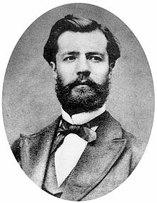
Capabilities frameworks
Henri Fayol’s original 14 principles (1916).
Division of Work.
Authority and Responsibility
Discipline
Unity of Command
Unity of Direction
Subordination of Individual Interest to the General Interest

Slide 13
Capabilities frameworks
7. Remuneration
8. Centralisation
9. Scalar Chain
10. Order
11. Equity
12. Stability of tenure
13.Initiative
14. Esprit De Corp.
https://www.economicsdiscussion.net/management/fayols-14-principles-of-management/32231

